Slide 1

Core Focus: Human-Robot seamless interaction
Summary
Evaluating Best-Fit Model
Evaluate Hyperparameters
Distance Prediction to Produce Number for STL Predicate
Multi-Color Distance Prediction: MLP and One-Hot Vector
Hyperparameter Search w/ MLP & one-hot vector & Masking Method
Channel Separation for Robot and Zone Method
Comparing Channel Separation and SAM Methods

Slide 2
Summary

Slide 3
Abstract:
Summary: Predict and autogenerate self-driving robots’ path in dynamic environments, such as disaster zone & warehouses human-robot workflow,
The research work is based on the concept that Vision-Learning model (VLM) can be used to dynamically generate real-valued signals (position, distance, coordinates etc.) VLM is an advanced AI algorithm that dynamically learns from images, video and text to understand and describe the visual content. The VLM automatically evaluates environments enabling a machine learning pipeline that automatically evaluates environments and generates Signal Temporal Logic (STL) predicates (formulas) for robot motion. SLT is a formulaic language to express safety, goal-reaching, and sequencing requirements over time, to optimize robot trajectories. My objective is to generate robotic command action sequences, guiding robots toward paths that maximize task effectiveness while satisfying spatial constraints. Realtime dynamic robot path generation for unchartered terranes is groundbreaking for unmanned robots. We validate this framework using satellite imagery for overhead scene analysis, demonstrating applications in domains such as disaster relief robotics and human–robot warehouse coordination

Slide 4
Evaluating Best-Fit Model

Slide 5
Evaluating Distance Prediction Model :
Problem: Create Distance Prediction Model to Produce Number for STL predicate
Last Week Best Model: 'conv_channels': [16, 32, 64], 'kernel_size': 3, 'linear_hidden_dim': 64, 'epochs': 20 Lowest Validation Loss: 6.6089
Changing:
Convolutional Channels
[16, 32, 64], [32, 64, 128], [8, 16, 32], [16, 32], [32, 64]
Kernal Size
1, 3, 5, 7
Linear hidden layers
32, 64, 128, 256
Epochs
10, 20, 30, 40, 50
Test more model combinations to determine best features
Metrics and visualizations
Objectives:
High accuracy
Low validation loss (MSE)
Low percentage error
Testing: 50 Models

Slide 6
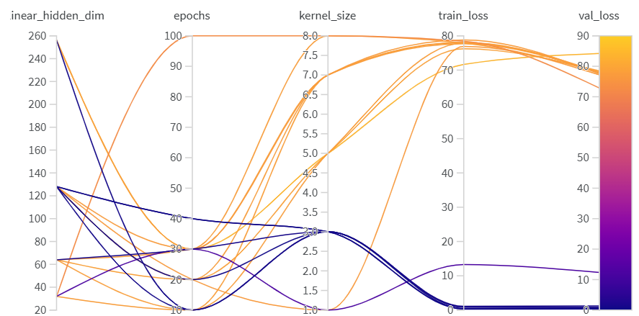
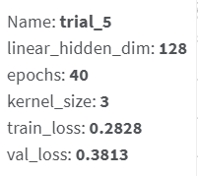
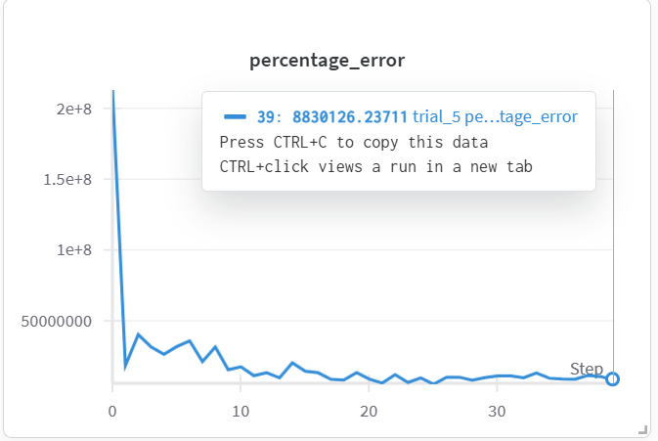
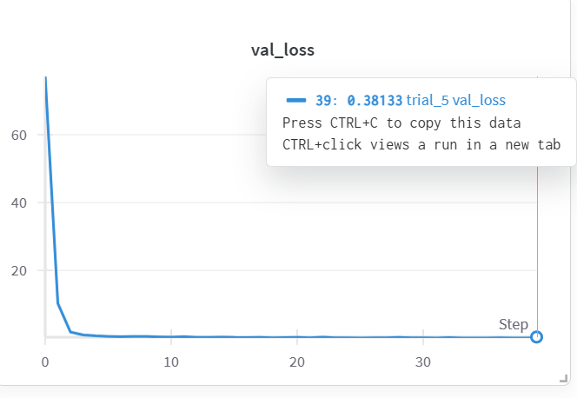
Model Evaluation:
Best Trial
Findings
Higher epochs doesn’t mean lower validation set loss
Kernel size balanced (3) leads to to better results
Best Trial
MSE: 0.381
Validation loss calculated through MSE
Low val_loss suggests more accurate predictions
Not good fit for small distances:
Percentage Error VERY high
Suggests inaccurate predictions for small distances
**need to validate wandb logging

Slide 7
Conclusions
Current Limitations:
Small distance percent errors
WandB
Tried to create histograms for every mode but led to crashing every program making non-iterable
Next Steps:
Best Model Histogram/boxplot/scatterplot w percent by actual
Check how well model fares for different distances
Check small distance predictions:
Log absolute error
Smaller test model to evaluate dataset
Advanced Dataset
Include color descriptors
Research further into amount of data (for just distance, >10,000)
Visualize data size vs training/validation loss
Resizing/scaling images for adaptability
Test on STL package

Slide 8
Evaluate Hyperparameters

Slide 9
Evaluating Hyperparameters to find best fit model:
Problem: Create Distance Prediction Model to Produce Number for STL predicate
Last Week Best Model: 'conv_channels': [16, 32, 64], 'kernel_size': 3, 'linear_hidden_dim': 64, 'epochs': 20 Lowest Validation Loss: 6.6089
Changing:
Convolutional Channels
[16, 32, 64], [32, 64, 128], [8, 16, 32], [16, 32], [32, 64]
Kernal Size
1, 3, 5, 7
Linear hidden layers
32, 64, 128, 256
Epochs
10, 20, 30, 40, 50
Test more model combinations to determine best features
Metrics and visualizations
Objectives:
High accuracy
Low validation loss (MSE)
Low percentage error
Testing: 50 Models

Slide 10
Model Evaluation:
Best Trial
Findings
Higher epochs doesn’t mean lower validation set loss
Kernel size balanced (3) leads to to better results
Best Trial
MSE: 0.381
Validation loss calculated through MSE
Low val_loss suggests more accurate predictions
Not good fit for small distances:
Percentage Error VERY high
Suggests inaccurate predictions for small distances
**need to validate wandb logging

Slide 11
Conclusions
Current Limitations:
Small distance percent errors
WandB
Tried to create histograms for every mode but led to crashing every program making non-iterable
Next Steps:
Best Model Histogram/boxplot/scatterplot w percent by actual
Check how well model fares for different distances
Check small distance predictions:
Log absolute error
Smaller test model to evaluate dataset
Advanced Dataset
Include color descriptors
Research further into amount of data (for just distance, >10,000)
Visualize data size vs training/validation loss
Resizing/scaling images for adaptability
Test on STL package

Slide 12
Distance Prediction to Produce Number for STL Predicate

Slide 13
Intro:
Problem: Create Distance Prediction Model to Produce Number for STL predicate
Last Week:
Test STL compatibility through STCG++
Create color labeled data
Objectives:
Implement Dynamics to create continuous data
Train model with continuous data
Train model with TanH function and new data
Normalizing data strategies
Loss function by percentage not MSE vs precision

Slide 14
Dynamics:
Control Choices:
[left, straight, right]
Function: control_from_direction:
Speed = 2m/s
+15 deg for left, 0 for straight, -15 deg right
Time step: 0.15 seconds
Wheelbase: L = 2.5 m
Simple Car Dynamics:
(x,y) state, and heading angle theta
X.dot = v (cos(theta))
Y.dot = v (sin(theta))
Theta.dot = v/L (tan(steering angle)
Data Requirements:
Buckets of small, large, and negative distances
Calculates signed distances for all colors
Example Data:
image_path,distance,color_word multicolor_clean_data/images/image_00001.png,18.6410,red multicolor_clean_data/images/image_00001.png,28.6353,green multicolor_clean_data/images/image_00001.png,14.1069,blue multicolor_clean_data/images/image_00002.png,19.1539,red multicolor_clean_data/images/image_00002.png,20.4128,green multicolor_clean_data/images/image_00002.png,19.2321,blue

Slide 15
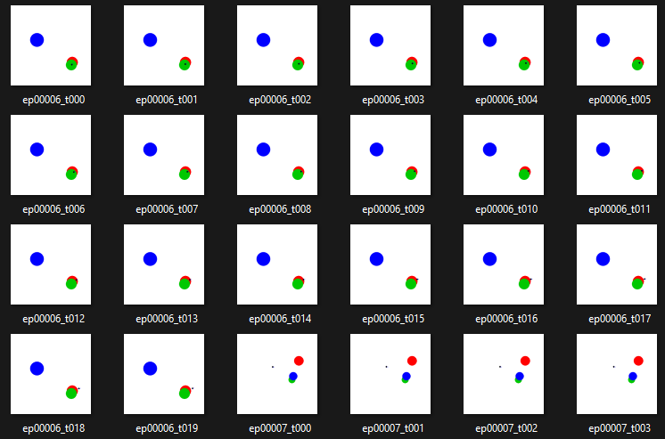
Data:

Slide 16
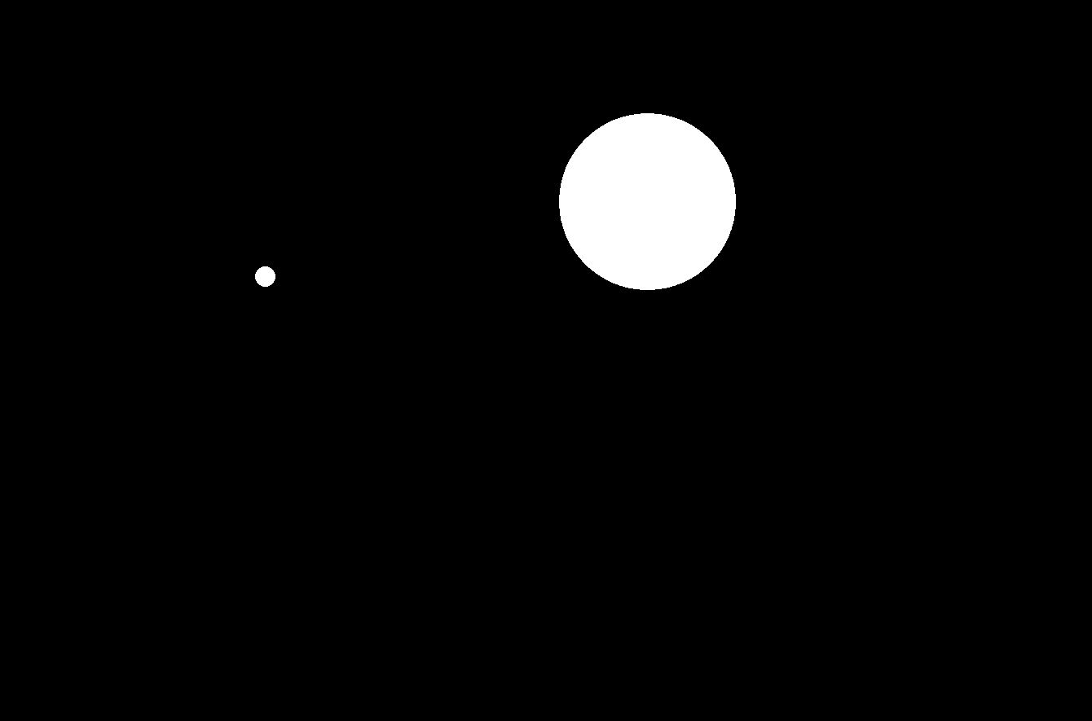
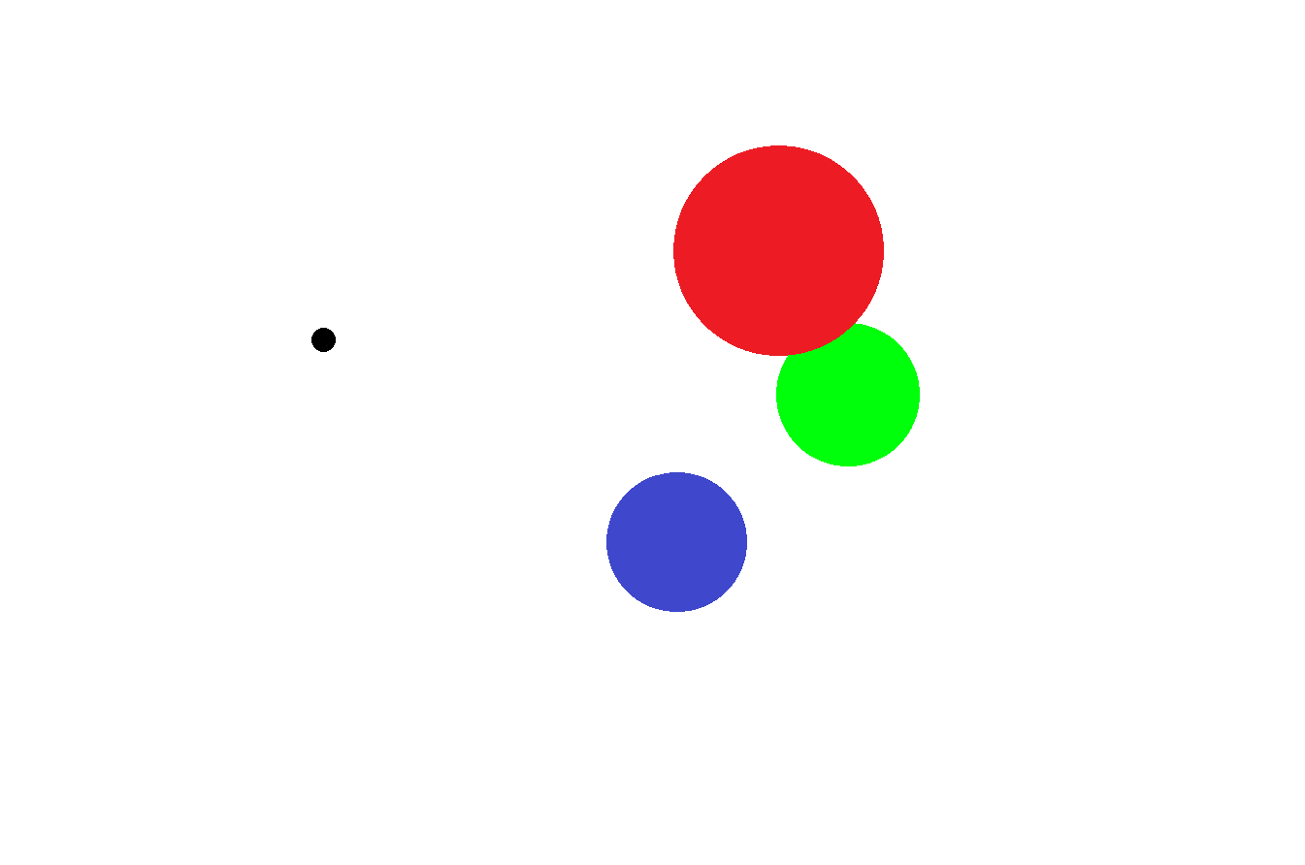
Conclusion/Next Steps
Conclusion:
New dataset generated
Dynamics and smoothing worked
Next Steps:
Train model with TanH function and new data
Normalizing data strategies
Already trained model but I did something wrong so that color was treated as a prediction instead of an instruction
Retrain with color being an input instead of output
Suggested Technique:
Color mask—did this in the first week; where by giving the color label you get a mask, then use the existing distance calculating model to calculate the distance through the mask
Separate color and masking distance calculation
Evalutate command action strings based on stl robustness evaluation

Slide 17
Multi-Color Distance Prediction: MLP and One-Hot Vector

Slide 18
Introduction:
Problem: Create Distance Prediction Model to Produce Number for STL predicate
Last Week:
Implement Dynamics to create continuous data
Train model with continuous data
Attempted multi-color distance predictor
Objectives:
Generate data with no zone overlapping
Evaluate what was wrong with previous attempt at multi-color distance predictor
Ultilize MLP and one-hot vectors to create the multi-color distance predictor

Slide 19
ML Flows:
Old Flow:
> Passes image through convolutional channels (8, 16, 32)
> Adaptive Average Pool vectorizes (128)
> Splits into two head predictors
Distance prediction (Linear function then ReLu, then Linear to one number) for single distance number (usual)
Same 128 vector (linear, TanH, then Linear to 5 numbers for each color
red, green, blue, white, black → highest is network guess
New:
> Passes image through convolutional channels (8, 16, 32)
> Adaptive Average Pool vectorizes (128)
> Concatenates the one-hot vector for the color
> MLP Head: linear (256), ReLu, linear, TanH (for guaranteed signed output between max and min distances)

Slide 20
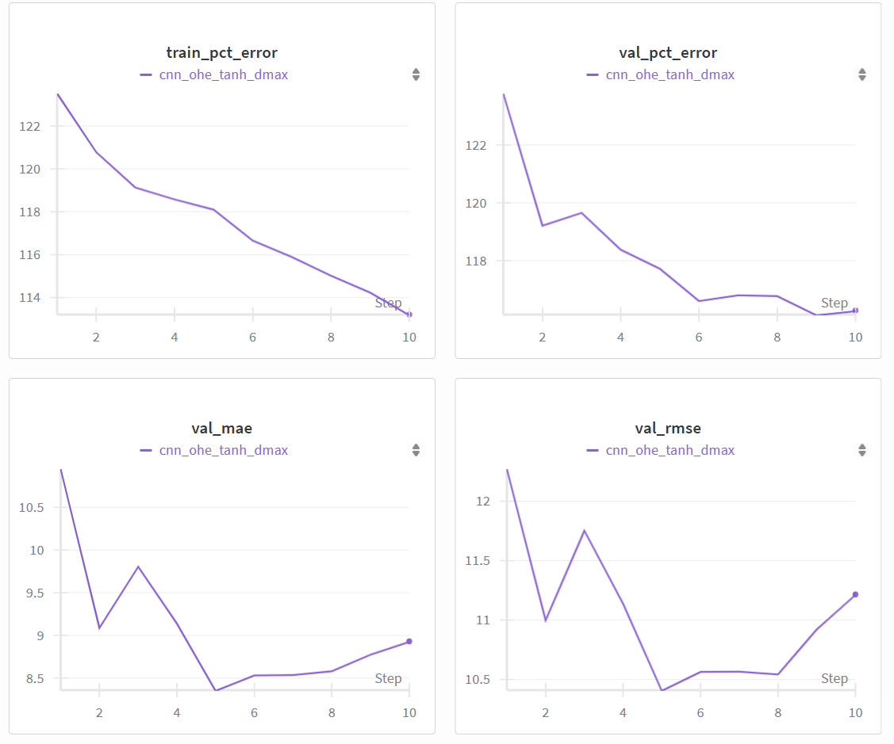
MLP Multi-Colored Distance Calculator Evaluation:
Loss Function:
SMAPE: Symmetric Mean absolute percentage error
Error relative to both prediction and truth
Percent = 200 * |prediction-truth| / (|prediction| + |truth|)
Better because always bounded by 200% instead of huge percentage error
MAPE
Mean absolute percentage error
Eps – small number added to the denominator to not divide by zero
Gets large around small numbers

Slide 21
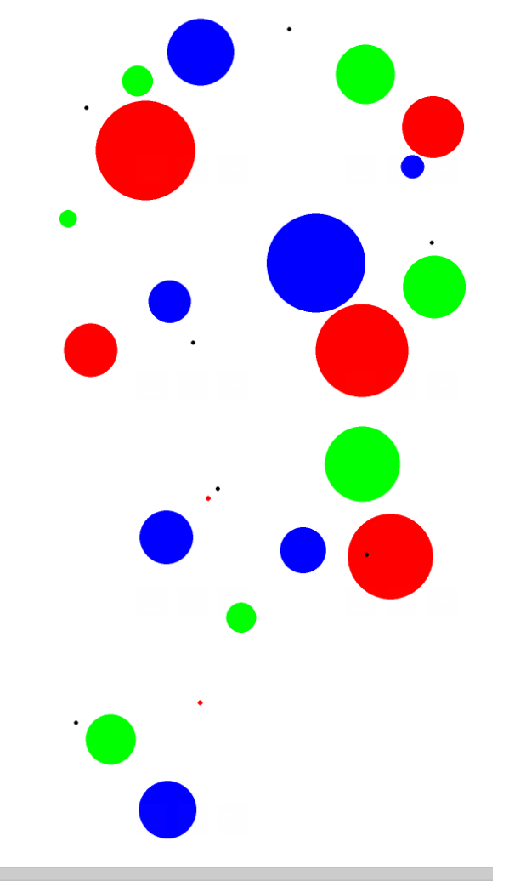
MLP Multi-Colored Distance Calculator Outputs:
image, color predicted actual
(image_00001.png, red) 3.94634 5.0026
(image_00001.png, green) 14.633493 9.5768
(image_00001.png, blue) 17.392704 21.8674
(image_00002.png, red) 14.561642 33.7043
(image_00002.png, green) 4.179651 13.5632
(image_00002.png, blue) 16.189943 40.8889
(image_00003.png, red) 15.555395 17.666
(image_00003.png, green) 23.859531 39.4734
(image_00003.png, blue) 9.57159 5.6872
(image_00004.png, red) 3.795057 19.1332
(image_00004.png, green) 11.555474 2.617
(image_00004.png, blue) 12.925599 15.8301
(image_00005.png, red) 18.685642 2.1527
(image_00005.png, green) 19.548832 27.205
(image_00005.png, blue) 4.906463 10.0071
(image_00006.png, red) 4.049764 -4.986
(image_00006.png, green) 6.395029 12.223
(image_00006.png, blue) 21.899042 9.2398
(image_00007.png, red) 18.35067 28.9854
(image_00007.png, green) 3.50825 2.7136
(image_00007.png, blue) 7.736016 22.8035

Slide 22
Conclusion/Next Steps
Conclusion:
MLP trained successfully
Optimized percent error gradient
Very inaccurate
Next Steps:
Consider the mask generation method
Research Paper steps:
Proof of concept [in progress]
Technical terms/methods
Integrate with stlcg++
Finding sequence of control actions to satisfy STL
Apply for real satellite views (real-world applications)

Slide 23
Hyperparameter Search w/ MLP & one-hot vector & Masking Method

Slide 24
Introduction:
Problem: Create Distance Prediction Model to Produce Number for STL predicate
Last Week:
Generate data with no zone overlapping
Evaluate what was wrong with previous attempt at multi-color distance predictor
Ultilize MLP and one-hot vectors to create the multi-color distance predictor
Objectives:
Conduct hyperparameter search with MLP/one-hot vector method
Conduct hyperparameter search with masking method
Evaulate correctness for both

Slide 25
Hyperparameter Training
Hyperparameters:
search_space = {
"conv_channels": [(16,32,64), (32,64,128), (8,16,32)],
"kernel_size": [3, 5, 7],
"embed_dim": [96, 128, 192],
"head_hidden": [32, 64, 128, 256],
"lr": [5e-4, 1e-3, 2e-3],
"weight_decay": [0.0, 1e-4, 1e-3],
"batch_size": [16, 32, 64],
"image_size": [50], # keep fixed unless you want to test others
"epochs": [5, 10, 20, 30, 50], # or [10, 20] if you want longer runs
"use_smape": [True], # or [True, False] to compare MAPE
"eps_frac": [0.02], # keep your current guard
}

Slide 26
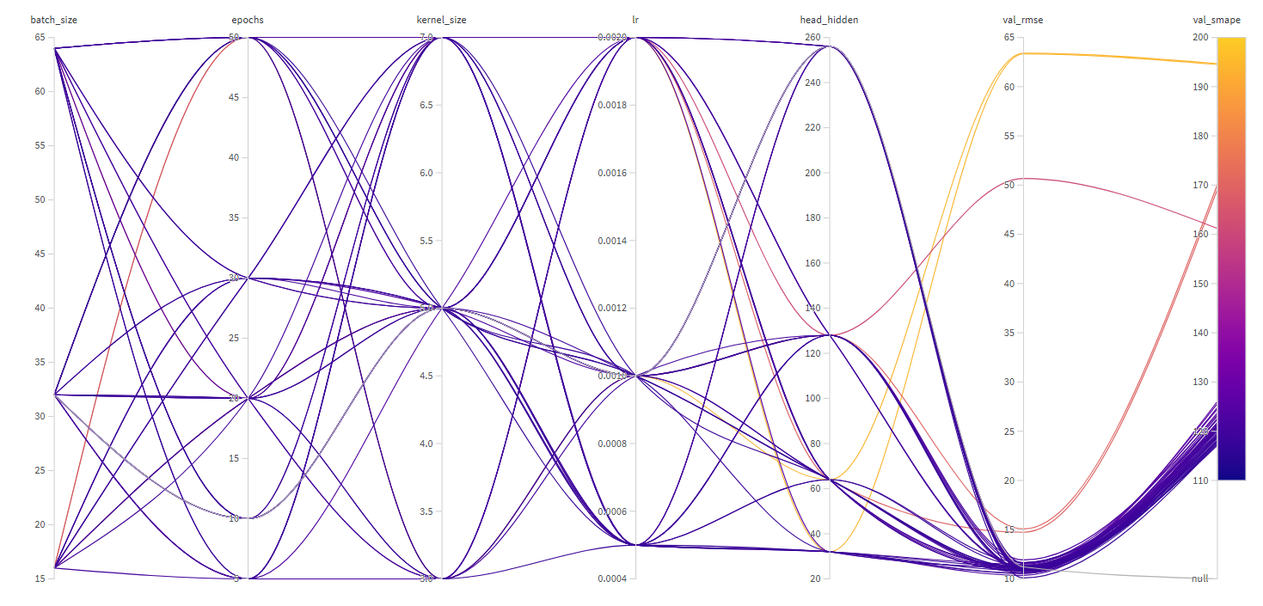
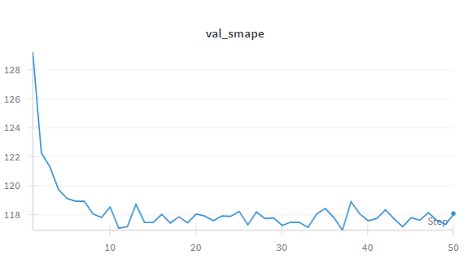
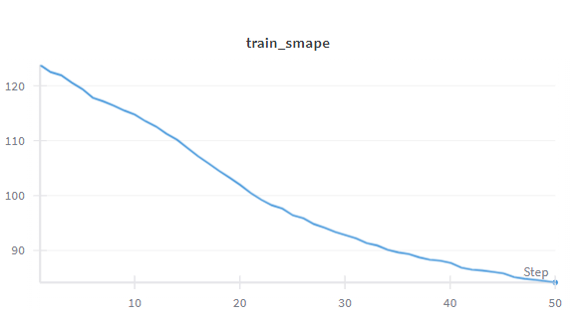
MLP/One-Hot Vector Method:
Loss Function – SMAPE
SMAPE Percent Range: 115%-118%
Lowest SMAPE: Trial 48
Rise upwards indicates overfit but mostly consistent
48

Slide 27
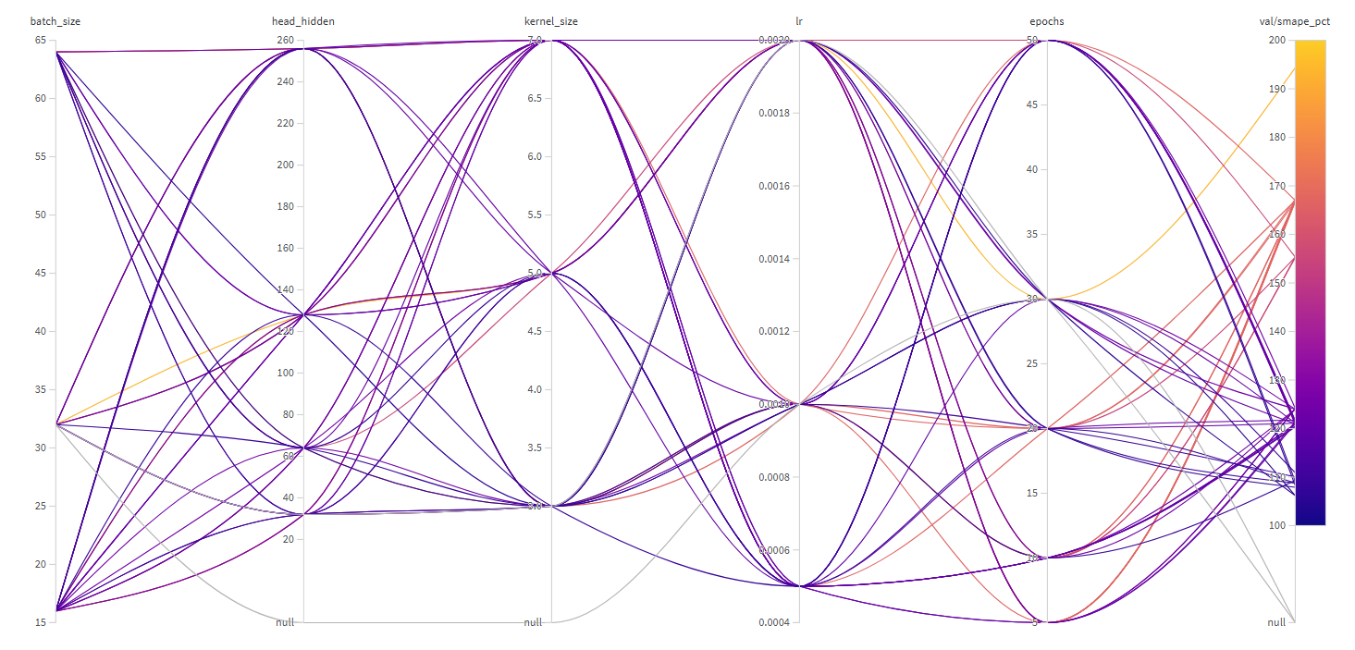
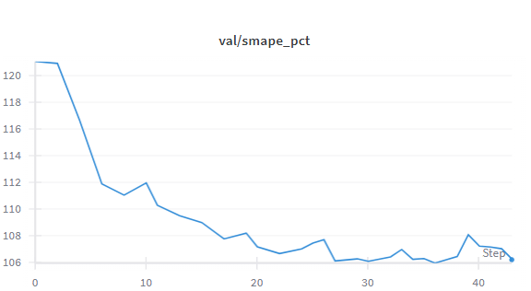
Masked Image Method
Loss Function – SMAPE
Lowest SMAPE: Trial 22
Input: a 50×50 grayscale mask (binarized 0/1).
Conv Block 1: 1→16 channels, 3×3 conv (same padding), ReLU, MaxPool2d(2) → output size 16×25×25.
Conv Block 2: 16→32 channels, 3×3 conv, ReLU, MaxPool2d(2) → output size 32×12×12.
Conv Block 3: 32→64 channels, 3×3 conv, ReLU, MaxPool2d(2) → output size 64×6×6.
Flatten: feature map → 2,304-dimensional vector (64×6×6).
Fully Connected Head: Linear(2304→128) → ReLU → Linear(128→128) → ReLU → Linear(128→1).
Output: pass through tanh (value in [-1,1]), then scaled by dataset max distance dmax → predicted signed distance in meters.

Slide 28
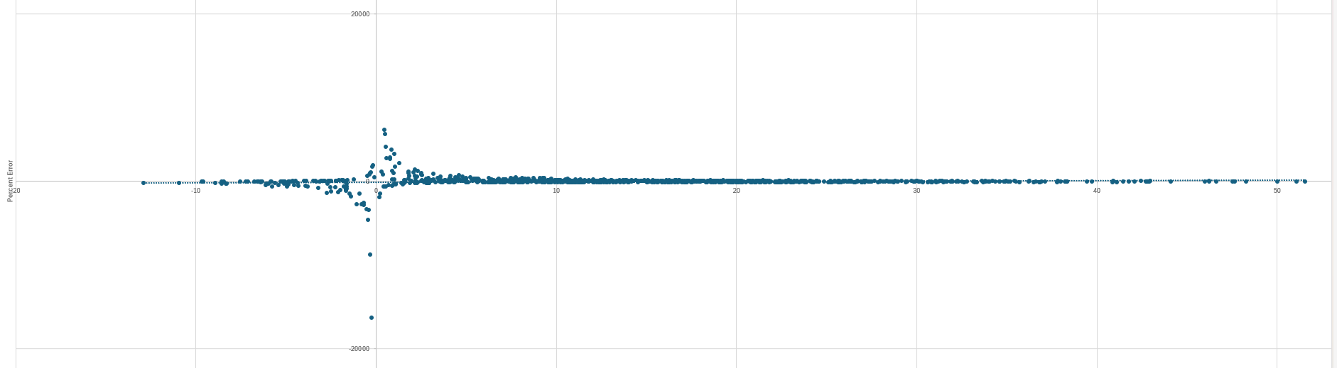
Percentage Error Graphs

Slide 29
Conclusion/Next Steps
Conclusion:
MLP and Masked Method trained well
Mask inaccurate for negative distances
Next Steps:
Research Paper steps:
Proof of concept [in progress]
Technical terms/methods
Integrate with stlcg++
Finding sequence of control actions to satisfy STL
Apply for real satellite views (real-world applications)

Slide 30
Channel Separation for Robot and Zone Method

Slide 31
Introduction:
Problem: Create Distance Prediction Model to Produce Number for STL predicate
Last Week:
Check why all the values are the same??
SAM source code + use coordinates to connect with model pipeline
Draw architecture with model steps and training losses +mathformulas
Evaluate good vs bad numbers (perfect score + how to interpret)
Sketch out different models w/ names, table with metrics and lossfunctions
Latex/overleaf writeup w technical language
Objectives:
Sperate channel for robot and zone method
Improve accuracy/correctness
Test accuracy/correctness based on sequential frames
Investigate SAM

Slide 32
Why are all the predicted Values the same?
true_distance | predicted_distance
8.228368 | 1.932941
3.613878 | 4.969524
17.65924 | 3.426874
11.34161 | 1.932941
6.052947 | 4.969524
17.40023 | 3.426874
14.972 | 1.932941
Deterministic Model:
The training finds a function to implement for any image
The same image inputted will always result in the same distance
Episode Change is too small:
Tried with "faster" robot
Numbers still didn't change
Robot is too small to register when image is reduced:
Made robot bigger
Numbers still didn't change:
Next Step:
Retrain whole model
Try MLP approach again
Batch dimension correct (stacked right in generation)
Check the excel script
17.834159 | 1.265169621
21.3018 | 1.265169621
25.056912 | 1.265169621
28.983329 | 1.265169621
33.146981 | 1.265169621
37.303049 | 1.265169621
38.9597 | 1.265169621
39.901835 | 1.265169621
40.98747 | 1.265169621
42.159023 | 1.265169621
43.49661 | 1.265169621
44.836275 | 1.265169621

Slide 33
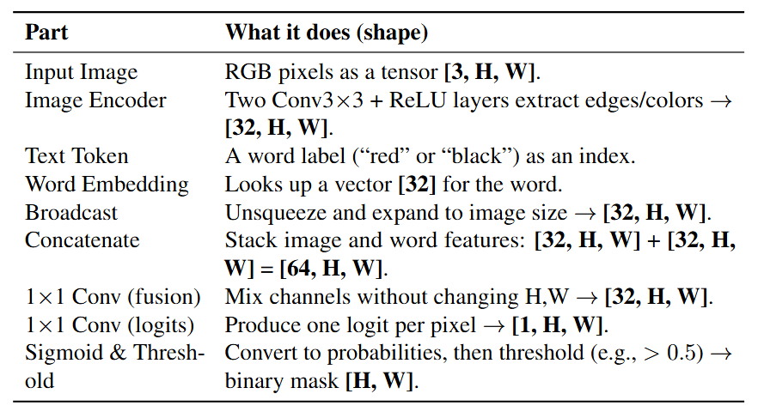
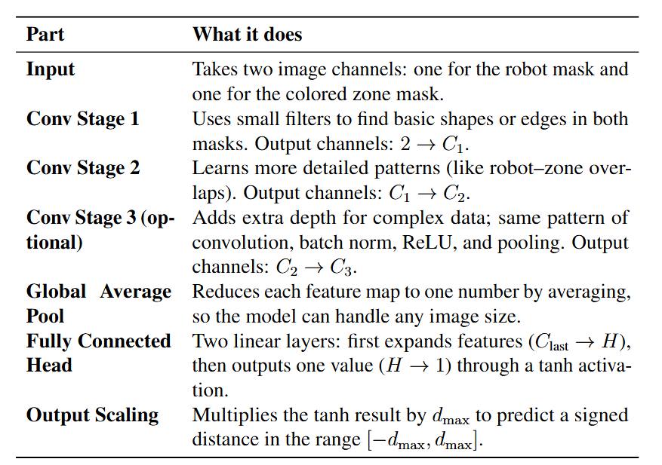
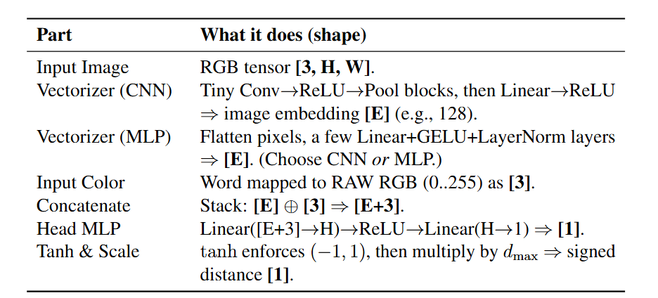
Different Models
Two Channels Method
Masks
MLP

Slide 34
Conclusion/Next Steps
Next Steps:
Retrain/try different model/approach to the distance calculator
Check the interpretation script (the excel)
Investigate if there are other premade options/research how to increase accuracy
Make model non-deterministic
Evaluate good/bad numbers
Evaluate accuracy of other models
With graphs
Add SAM direct to Pipeline w/ sattelite imagery
Videos vs images
NERFS:
Implicit neural representation
Approximate function using a neural network instead of through exact geometry

Slide 35
Comparing Channel Separation and SAM Methods

Slide 36
Introduction:
Problem: Create Distance Prediction Model to Produce Number for STL predicate
Last Week:
Conduct hyperparameter search with MLP/one-hot vector method
Conduct hyperparameter search with masking method
Evaulate correctness for both
Objectives:
Sperate channel for robot and zone method
Improve accuracy/correctness
Test accuracy/correctness based on sequential frames
Investigate SAM

Slide 37
Hyperparameter Training
Hyperparameters:
search_space = {
"conv_channels": [(16,32,64), (32,64,128), (8,16,32)],
"kernel_size": [3, 5, 7],
"embed_dim": [96, 128, 192],
"head_hidden": [32, 64, 128, 256],
"lr": [5e-4, 1e-3, 2e-3],
"weight_decay": [0.0, 1e-4, 1e-3],
"batch_size": [16, 32, 64],
"image_size": [50], # keep fixed unless you want to test others
"epochs": [5, 10, 20, 30, 50], # or [10, 20] if you want longer runs
"use_smape": [True], # or [True, False] to compare MAPE
"eps_frac": [0.02], # keep your current guard
}

Slide 38
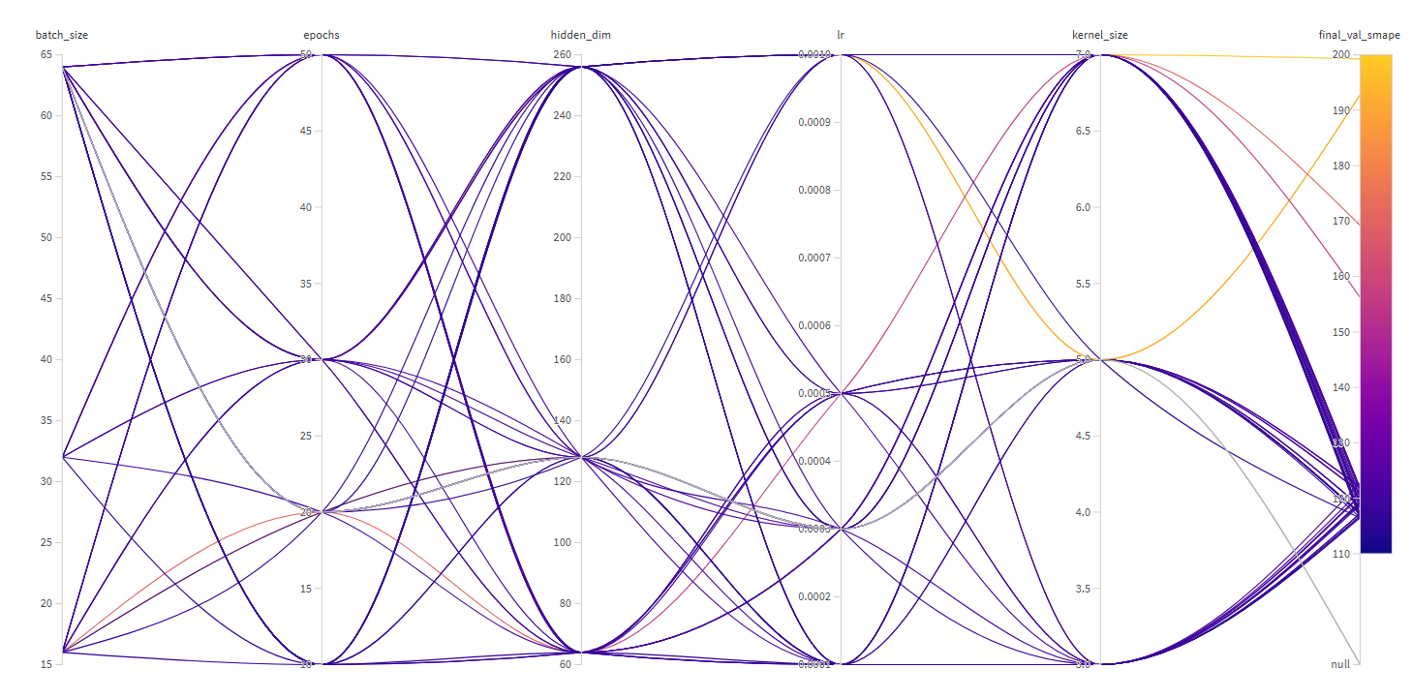
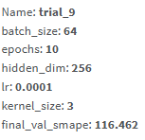
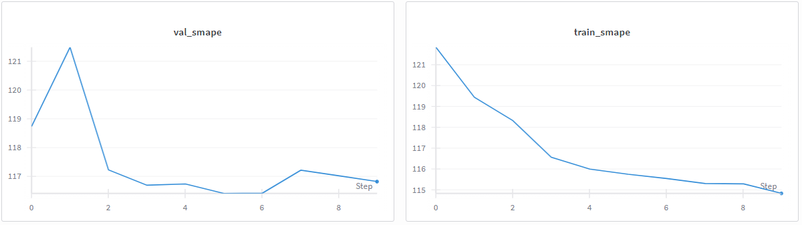
Channels method
Loss Function – SMAPE
SMAPE Percent Range: 115%-118%
Lowest SMAPE: Trial 9
Rise upwards indicates overfit but mostly consistent

Slide 39
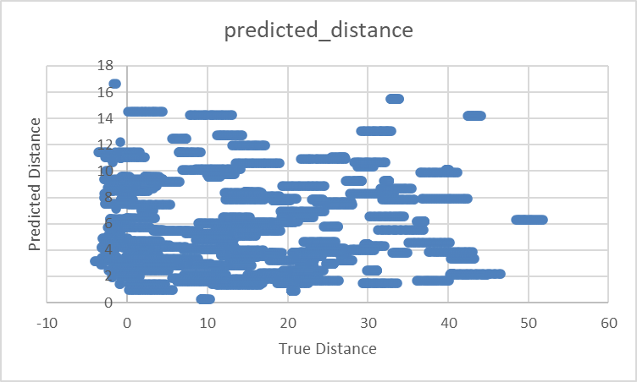
Graphs
Predicted Distance vs True Distance
Indicates accuracy –no pattern :(
No negative guesses
No correlation of inaccuracy based on true distance

Slide 40
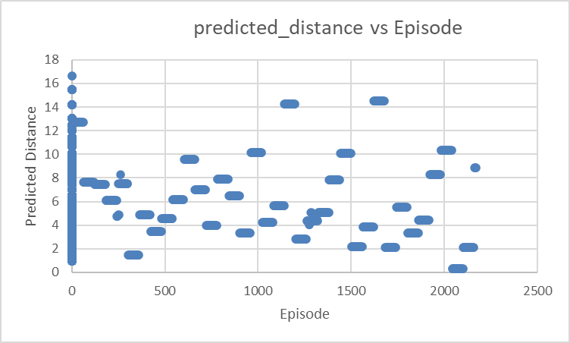
Graphs
Predicted Distance vs Episode
No pattern
The values in an episode are exactly the same--> evaluate with greater changes in distance?
Smaller images
Longer episodes

Slide 41
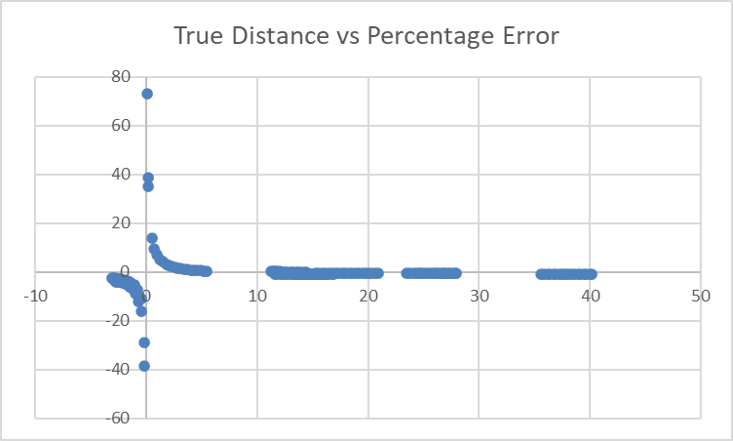
Graphs
True Distance vs Predicted distance
Indicates that distances are more innacurate at smaller values (expected)

Slide 42
Percentage Error Graphs

Slide 43
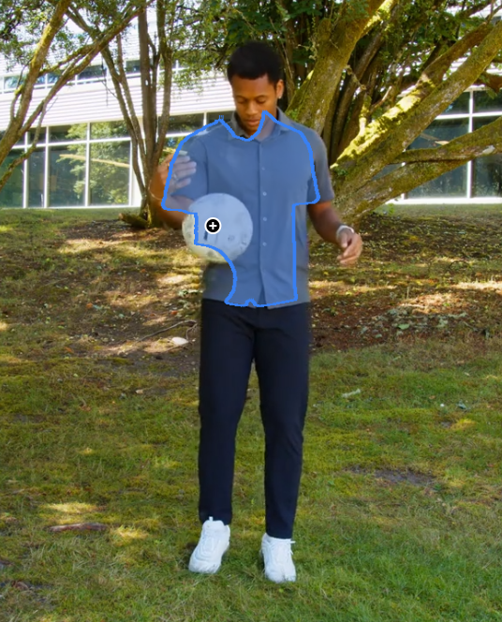
Conclusion/Next Steps
Conclusion:
Channel method is extremely accurate but more suited to satellite imagery
SAM can be used for segmentation but may require human cleaning
Next Steps:
Check why all the values are the same?
SAM source code + use coordinates to connect with model pipeline
Draw architecture with model steps and training losses +math formulas
Evaluate good vs bad numbers (perfect score + how to interpret)
Sketch out different models w/ names, table with metrics and loss functions
Latex/overleaf writeup w technical language
Research Paper steps:
Proof of concept [in progress]
Technical terms/methods
Integrate with stlcg++
Finding sequence of control actions to satisfy STL
Apply for real satellite views (real-world applications)

